Slide 1
AORTIC DISSECTION
DR NIYAS K NASEER
SR CARDIOLOGY

Slide 2
SUBTITLES
HISTORY
EPIDEMIOLOGY
CLASSIFICATION
CAUSES AND PATHOGENESIS
CLINICAL MANIFESTATIONS
LABORATORY FINDINGS
DIAGNOSTIC TECHNIQUES
MANAGEMENT AND PROGNOSIS
AD VARIANTS
GUIDELINES

Slide 3

HISTORY
King George 2 of Great Britain died(october 25,1760)while training on the commode and was the first well documented case of an aortic dissection
Notes:
, but a number of other well-known figures have been diagnosed as well, including Lucille Ball, John Ritter, and Dr. Michael DeBakey.

Slide 4
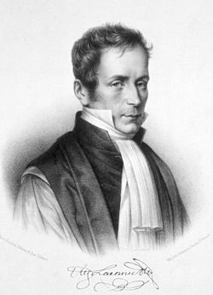
Historical Note
term "aortic dissection" was introduced by the French physician J.P. Maunoir in 1802
Lannaec(French physician) introduced term Dissection aneurysm in 1819

Slide 5
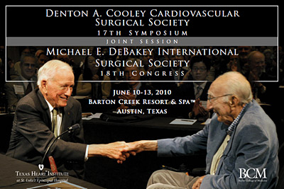
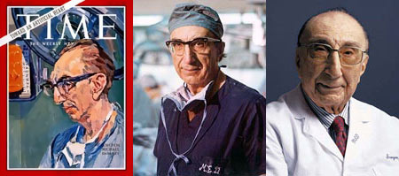
Historical Note
First successful outcome of modern treatment of aortic dissection was attributed to Dr. DeBakey in his report, 1955 and later he devised a classification that is widely used today as Debakey classification
Notes:
death in 2008 at the age of 99

Slide 6
Historical Note
Technological and technical improvements follow:
  Cardiopulmonary bypass circuit
  Synthetic placements
  Hypothermic circulatory arrest in 1960s to 1975( Barnard , Schrire, Borst and Griepp with colleaques)
  Open distal anastomosis technique by Livesay in 1982
  Bioglue has been approved by US FDA to strengthen the disrupted layer

Slide 7
EPIDEMIOLOGY
2.0–3.5 people per every 100,000 every year
Studies from Sweden suggest that the incidence are rising
Dissection occurs in about 0.6% of pregnancies
male to female - 2:1
Very high early mortality(1% per hour)in the first 24 hours
Type A aortic dissection - 50 to 60 years/type B dissection -60 to 70 years

Slide 8
Acute aortic syndromes :
classic aortic dissection (80% to 90% )
aortic intramural hematoma (IMH)(10% to 20%)
penetrating atherosclerotic aortic ulcer (5% )

Slide 9
Two main hypotheses for acute aortic dissection:
a primary tear in the aortic intima with blood from the aortic lumen penetrating into the diseased media
primary rupture of the vasa vasorum leading to hemorrhage in the aortic wall, with subsequent intimal disruption

Slide 10
CLASSIFICATION

Slide 12
65% of intimal tears occur in the ascending aorta, 30% in the descending aorta, less than 10% in the aortic arch, and approximately 1% in the abdominal aorta

Slide 13
CAUSES AND PATHOGENESIS
Notes:
IRAD registry of 4428 patients,conditions associated with dissection included: hypertension (77%), atherosclerosis (27%), previous cardiac surgery (16%), known aortic aneurysm (16%), MFS (4%), and iatrogenic condition (3%)

Slide 14
GENETIC DISDORDERS

Slide 15
MARFANS SYNDROME
Excessive signaling in the TGF-β pathway and abnormalities in function of the SMC contractile element may underlie certain aortic aneurysm syndromes
1 in 5000 individuals- accounts for approximately 4% (dissection in young patients mainly)
After elective root replacement in MFS- 1.5% annual risk of type B aortic dissection
genetic mutations - Variants at the rs2118181 locus on the FBN1 gene and mutations in the KIF6 gene

Slide 16
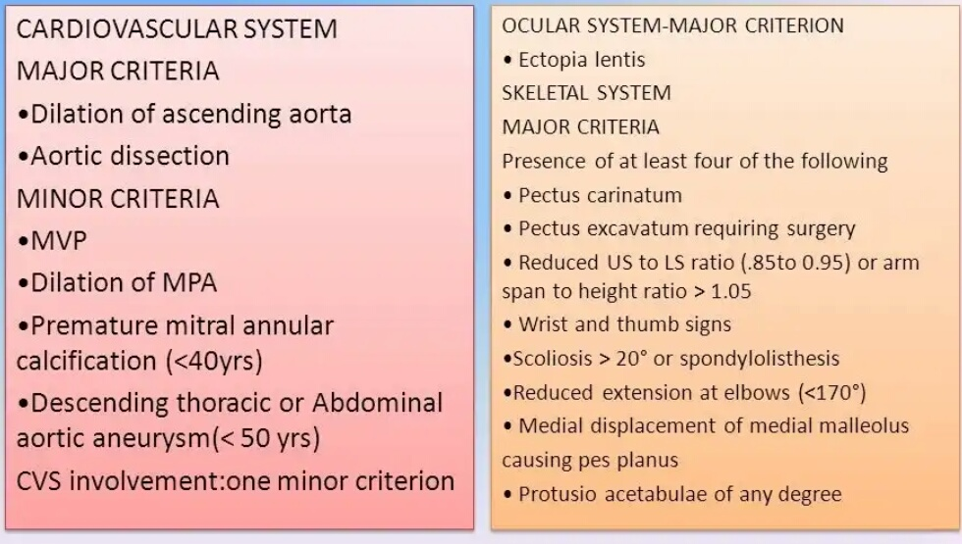
GHENTS CRITERIA

Slide 17
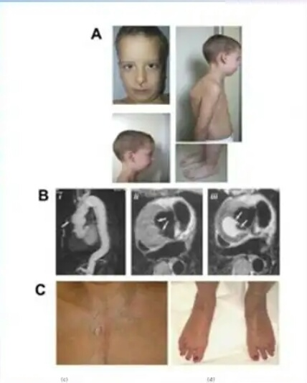
LOEYS-DIETZ ANEURYSM SYNDROME
Autosomal dominant
Mutations in TGFBR1 OR TGFBR2
Arterial tortuosity , hypertelorism ,bifid or broad uvula , cleft palate
Soft, velvety skin and easily visible veins
Aortic dissection and aneurysm involving branch vessels

Slide 18
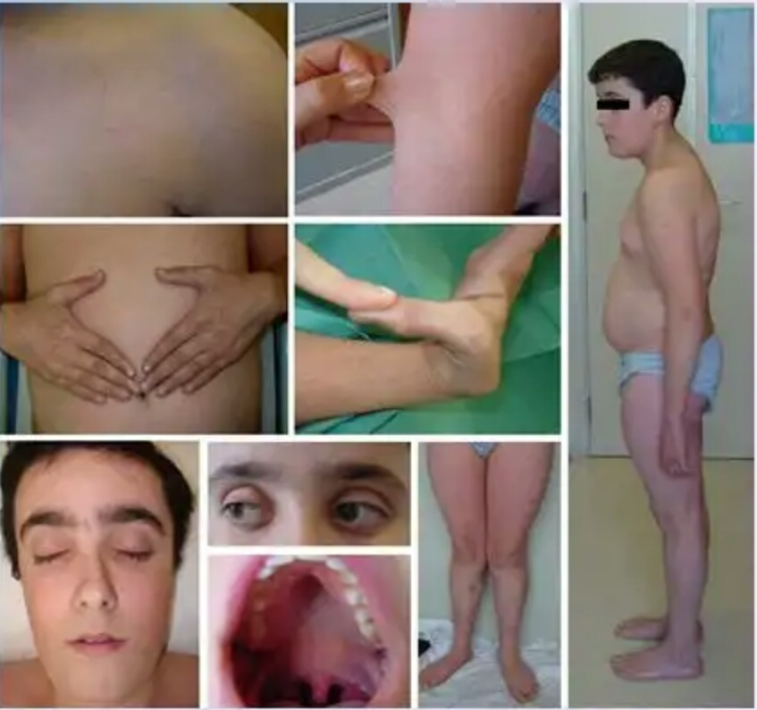
Vascular Ehlers-Danlos Syndrome(type 4)
Autosomal dominant
Mutation in gene COL3A1
Abnormal type III procollagen synthesis
Hyperflexible fingers, hyperlucent skin with visible veins , easy bruisability and varicose vein
High risk for spontaneous arterial dissection and rupture oftenin medium sized arteries

Slide 19
BAV is an important risk factor for ascending aortic aneurysm and dissection
Aortic dissection may complicate aortitis
TAA have risk for aortic dissection, with risk for dissection and rupture increasing as aneurysm size increases
Aortic dissection can occur during late pregnancy or in the early postpartum period- Attribute to hemodynamic factors and hormonally induced changes in aortic wall

Slide 20
CLINICAL MANIFESTATIONS
SYMPTOMS - a high index of suspicion
Pain –severe, sudden onset, with maximum intensity occurring at its inception
a “sense of doom”
quality - “sharp” “severe” or “stabbing” and adjectives such as “tearing” or “ripping”
Migratory- radiate from the chest to the back or vice versa
may lessen or resolve which makes diagnosis even more challenging
In some patients the symptoms related to a complication - e.g., congestive heart failure (CHF) (<10%), syncope (9%),acute stroke (6%), acute MI, paraplegia, and cardiac arrest or sudden death dominate
Notes:
Anterior chest pain is more commonly associated with Type A AD,whereas patients with Type B dissection present more frequently with pain in the back or abdomen

Slide 21
CLINICAL MANIFESTATIONS

Slide 22
Physical Findings
Highly variable - range from virtually unremarkable to full cardiac arrest
Hypertension occurs in approximately 70%
typical—pulse deficits, AR, and neurologic manifestations—are more characteristic of ascending than descending dissection
pulse deficit -31% of type A dissections and 19% of type B dissections

Slide 23
Malperfusion
may be dynamic, static, or mixed
Dynamic malperfusion (MC) results from the overpressurized false lumen pushing the septum toward the true lumen
Static malperfusion results from stenosis or occlusion of a branch artery caused by the dissection flap, hematoma, embolism, or thrombosis

Slide 24
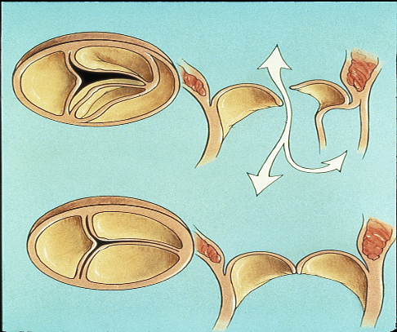
Aortic regurgitation
key diagnostic feature of type A dissection, occurs in 41% to 76% of patients
murmur of AR varies in intensity, depending on BP and the degree of heart failure
Mechanisms of AR include
incomplete coaptation of the aortic leaflets - concurrent dilation of the aortic root and annulus or by acute aortic dilation from an expanding false lumen leading to central aortic regurgitation
aortic leaflet prolapse - dissection flap propagating into the aortic leaflets or commissures or by distortion of proper leaflet alignment by an asymmetric dissection flap
extensive or circumferential dehiscing intimal flap prolapsing into the left ventricular outflow tract during diastole and interfering with valve coaptation
preexisting AR - underlying aortic root aneurysm or BAV disease

Slide 25
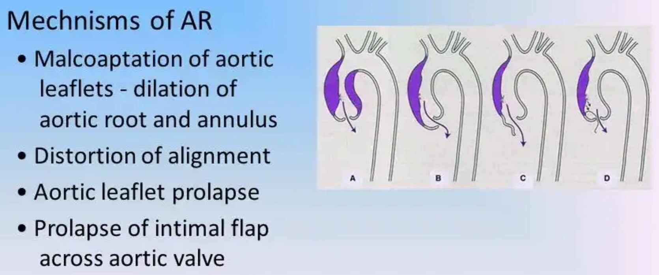

Slide 26
Neurologic manifestations
occur in 17% to 40% ;more common with type A dissections
Syndromes include persistent or transient ischemic stroke,spinal cord ischemia, ischemic neuropathy, and hypoxic encephalopathy and are related to malperfusion of one or more branches supplying the brain, spinal cord or peripheral nerves
Ischemic stroke occurs in approximately 6% of patients with type A dissection
Notes:
Less common neurologic manifestations : seizures,transient global amnesia, ischemic neuropathy, disturbances in consciousness and coma, and paraparesis or paraplegia related to spinal cord ischemia. Coma and cerebral malperfusion are associated with poor outcomes

Slide 27
Syncope occurs in 19% of type A and 3% of typeB aortic dissection
may be related to
acute hypotension (caused by cardiac tamponade, severe AR, or aortic rupture)
obstruction of a cerebral vessel
activation of cerebral baroreceptors

Slide 28
Acute MI
false lumen compressing the coronary ostium or the dissection flap involving the coronary artery complicates 1% to 2% of patients with acute type A aortic dissection
most frequently - right coronary artery and leads to acute inferior MI
Troponin elevations and electrocardiographic changes may occur
CAG in a patient with STEMI shows no culprit lesion - aortic dissection should be excluded

Slide 30
vascular complications and malperfusion
Renal artery -5% to 10% (renal ischemia, infarction, or renal insufficiency or refractory hypertension )
Mesenteric ischemia -<5%
left-sided pleural effusion, -an inflammatory response. Acute hemothorax may result from rupture
Type A aortic dissection may be accompanied by acute pericarditis Acute cardiac tamponade as a result of rupture with hemopericardium complicates approximately 9% of type A dissections

Slide 31
ORGAN SYSTEM COMPLICATION

Slide 32
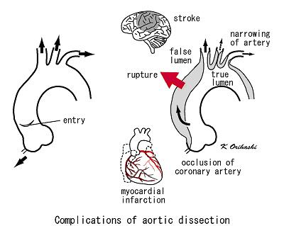

Slide 33
INVESTIGATIONS

Slide 34
CHEST X-RAY
Signs of dissection –
abnormal aortic contour
widening of the aortic silhouette (83% of type A; 72% of type B).
Pleural effusions occur in approximately 20%
Displacement of trachea to right and distortion of left main stem bronchus
IRAD survey-normal chest x-ray findings on presentation were found in 29% of type A and 36% of type B dissections

Slide 36
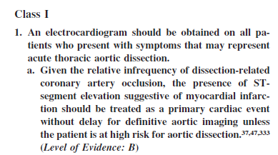
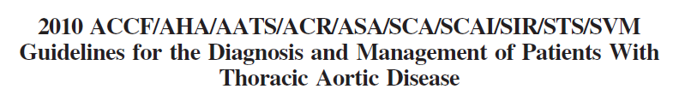
EKG
  Normal in 1/3 ( in coronary involement)
  ST-T change

Slide 37
LABORATORY FINDINGS

Slide 38
BIOMARKERS
Medial injury - Release of smooth muscle proteins (calponin), soluble elastin fragments, myosin heavy chain and the BB isoform of creatine kinase, fibrin degradation products and TGF-β (limited use)
elevated D-dimer -useful biomarker for classic acute dissection
< 500 ng/mL in 24hrs had a negative likelihood ratio of 0.07 and a negative predictive value of 95% ,sensitivity of 97% and a specificity of 47%
>1600 ng/ml in first 6hrs –positive likelihood of 12.8
Normal D-dimer levels can occur with aortic dissection and a thrombosed false lumen, as well as with aortic IMH

Slide 39
Diagnostic imaging

Slide 41
Computed Tomography
most often used - best performed with an ECG-gated, multidetector scanner(eliminate aortic pulsation motion artifacts)
FEATURES:
two distinct lumens with a visible intimal flap or by detection of two lumens by their differing rates of opacification with contrast material
If the false lumen is completely thrombosed-low attenuation,slower flow and a larger diameter than the true lumen
sensitivity and specificity of 98% to 100%
Spiral (helical) CECT allows threedimensional
OTHER - hemopericardium, aortic rupture, branch vessel involvement, and blood supply from the true and false lumens

Slide 42
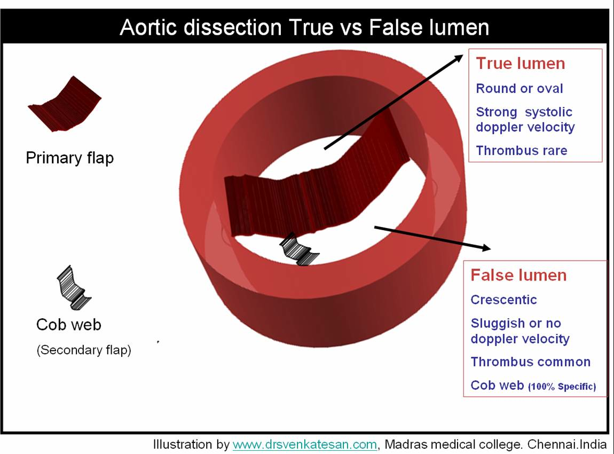
Notes:
-True Lumen: Round or oval, usually smaller, can be surrounded my calcified intima, permanent systolic pressure (doppler), for type B AD it feeds celiac A, SMA, and Rt Renal A.
-False: Crescent, usually larger, usually on the outer curvature of the Aorta in Type A, delayed contrast filling (20-60 sec), wedge around the true lumen and can loop around is a spiral pattern and form CT contrast image called (bird beak), thrombi and cobwebs (secondary flap, reminants of media collagenous materials) are common, Lt Renal A usually originates from False lumen in Type B AD.

Slide 43
Imaging without contrast should be used first to detect haemorrhage and haematomas because displacement of intimal calcification within the aortic lumen is a typical finding in dissection
Triple-rule out- ECGgated 64-detector CT study to evaluate patients with acute chest pain, in ED, for : AD, pulmonary embolism, and coronary artery disease
pulsation artefact - is the most common cause of misdiagnosis caused by pulsatile - can be eliminated with ECGgating or else by a linear interpolation reconstruction algorithm

Slide 44
Major limitations -inability to evaluate the coronary arteries and aortic valve reliably, motion artifact related to cardiac movement, streak artifact related to implanted devices, and complications associated with the use of contrast agents, especially nephropathy

Slide 45
Magnetic Resonance Imaging
sensitivity and specificity of 98%
Does not require IV iodinated contrast material or ionizing radiation
permits multiplanar imaging with 3D reconstruction and cine-MRI for visualization of blood flow, differentiation of slow flow and clot, evaluation of intimal flap mobility, and detection of AR
can assess branch vessel morphology when combined with contrast-enhanced MRA

Slide 46
Detect pericardial effusion, aortic rupture, entry points, and exit points with a high level of accuracy
MRA may detect and quantify AR
TL shows signal void, whereas the FL shows higher signal intensity indicative of turbulent flow

Slide 47
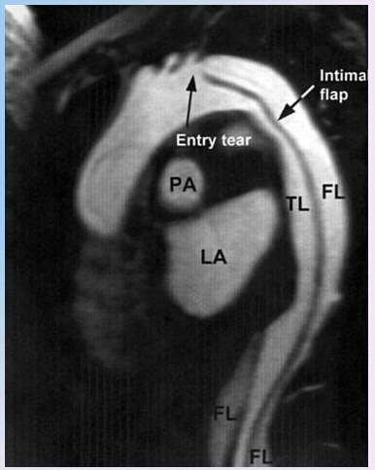
limitations –
evaluating acute aortic dissection
contraindicated - implantable devices (pacemaker, defibrillator) and other metallic Implants
availability on an emergency basis
more time is needed to acquire images

Slide 48
Ultrasound
undulating intimal flap with independent motion within the aortic lumen that separates the true and false lumens
Color flow Doppler demonstrates differential flow in the two lumens and can detect intimal tears
When the false lumen is thrombosed,displacement of intimal calcification or thickening of the aortic wall suggests aortic dissection
Aortography
no longer used
used mainly during endovascular repair or coronary angiography

Slide 49
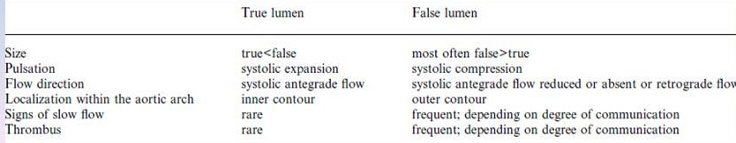
Transthoracic Echocardiography
type A aortic dissection -sensitivity of 70% to 80% and specificity of 93% to 96%
type B aortic dissection -it is much less sensitive (31% to 55%)
negative findings do not exclude acute aortic dissection

Slide 50
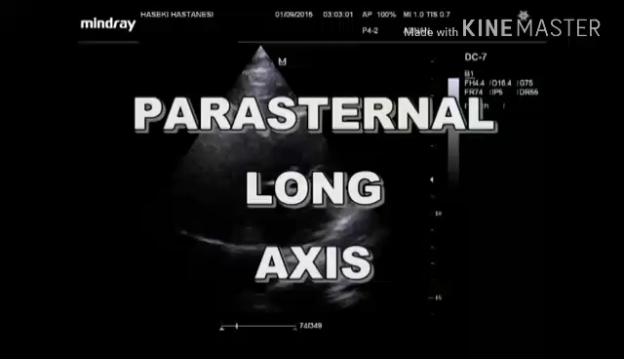

Slide 51
TEE
highly accurate
Sensitivity approximately 98%; specificity, 95%(operator dependent )
may not completely visualize the distal ascending aorta and proximal aortic arch
visualize the intimal tear in 75% to 100% of cases, differentiate the true and false lumens
true lumen: smaller lumen, systolic expansion, systolic anterograde flow, communication from the true to the false lumen in systole
100% sensitive in detecting AR complicating dissection and may define its mechanism
provides information about left ventricular function, the proximal coronary arteries, and pericardial effusion and may assist with endovascular treatment

Slide 53
Role of Coronary Angiography
Routine coronary angiography is not recommended before surgery for acute type A aortic dissection
delay in emergency surgery
technically difficult - Arterial access may fail to gain entry into the true lumen, and injury to the aorta from the catheter or guidewire may cause extension of the dissection or perforation of the aorta
patients undergoing surgery for acute type A dissection, coronary artery involvement by the dissection can most often be corrected intraoperatively, and angiography is not required.

Slide 56
Evaluation and Management Algorithms

Slide 58
MANAGEMENT

Slide 61
HR AND BP MANAGEMENT
Target:100 to 120 mm Hg or the lowest level necessary for adequate perfusion and a heart rate (HR) of 60 to 80 beats/min
Beta blockers -even if the patient does not have hypertension- reduce dP/dt and stress on the aorta
Esmolol - initial bolus of 1000 μg/kg and then as a continuous infusion of 150 to 300 μg/kg/min.
Labetalol -initial IV dose of 20 mg over 2 minutes and then at 40 to 80 mg every 10 minutes (maximum dose, 300 mg) until the desired response is achieved then administered by continuous infusion at a rate of 2 to 10 mg/min, up to 300 mg

Slide 62
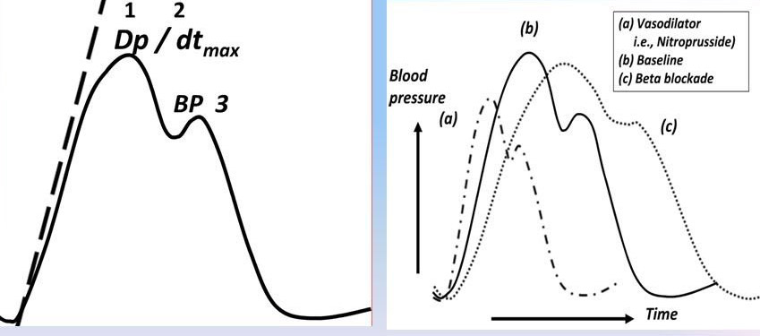

Slide 63
Sodium nitroprusside - rapid reduction of BP but also may result in an increase in dP/dt - dose of 0.3 to 0.5 μg/kg/min, uptitrating by 0.5 μg/kg/min
IV ACE inhibitors , IV nitroglycerin or IV nicardipine (5 mg/hr, can be increased to a maximum of 15 mg/hr)
consider renal artery malperfusion
BP wane after the first several days - Persistence = signs of renal ischemia

Slide 65
Cardiac tamponade
8% to 31% of acute type A dissections
one of the MC mechanisms of death- have double the inhospital mortality rate (54% versus 25%)
hypotension, syncope, or altered mental status
Pericardiocentesis for acute hemopericardium - recurrent bleeding and acute hemodynamic collapse, especially if a larger volume of fluid is removed and increased BP leads to further brisk bleeding into the pericardial space
relatively stable patient - the risks associated with pericardiocentesis probably outweigh its benefits
requires emergency aortic surgery
Contained pericardiocentesis to stabilize the patient before surgery may be lifesaving

Slide 66
DEFINITIVE THERAPY – type A
Surgery is the treatment of choice
mortality 50% within the first 48 hours if not operated
IRAD- mortality rate- undergoing surgery 18% vs 56% medically
In experienced centers, 30-day surgical mortality for acute type A dissection is 10% to 35%
Factors increasing mortality - shock, heart failure,cardiac tamponade, MI, renal failure, age, and malperfusion
surgery reduces 1-month mortality from 90% to 30%

Slide 67
SURGICAL MANAGEMENT
Aim - prevent the common complications of dissection, including cardiac tamponade, AR, aortic rupture, stroke, and visceral ischemia
immediate surgical goals –
  excise the intimal tear
  to obliterate the false channel by oversewing the edges of the aorta
  reconstitute the aorta- directly or more often with placement of an interposition graft
Notes:
weigh the risks of surgery in a low-volume center versus the risk associated with a delay in transfer to a site with expertise

Slide 68
controversy -timing of directly treating malperfusion
rule is - repair the aorta first because this will correct the malperfusion
When severe malperfusion syndrome due to mesenteric ischemia or descending aortic pseudocoarctation is present- initial TEVAR to the descending aorta be performed
However, associated with delay in definitive surgery and interim rupture rates of 5% to 23%

Slide 69
A woven polyester vascular graft replaces the ascending aorta
Intraoperative aortic valve inspection and TEE guidance assist in managing the aortic valve in patients with proximal aortic dissection
hemiarch replacement - tear localized to the ascending aorta, with a normal-size arch without distal malperfusion

Slide 70
AR complicates dissection:
repair of the aortic wall, decompression of the false lumen, and resuspension of the commissures to the aortic wall will usually restore valve competence
When aortic leaflet disease precludes repair, AVR plus ascending aortic replacement is indicated
When the sinuses are dilated, composite valve and root replacement is often performed via the modified Bentall procedure
If the sinus of Valsalva is involved by dissection- preferable to replace the aortic root to prevent late AR
When the aortic root is dilated but the aortic leaflets are normal, many have achieved success by performing a reimplantation with valve-sparing root replacement

Slide 71
STEPS
A median sternotomy
cannulation for cardiopulmonary bypass generally involves the axillary artery or less often the femoral approach to avoid trauma to the weakened aortic wall

Slide 72
Notes:
Pledgeted, double-armed, polypropylene sutures are placed across each detached commissure and through outer
layer of aorta, and are tied over a second pledget. Inset: Gelatin-resorcinol-formaldehyde or other glue may be used to obliterate false
lumen. E, Disrupted layers of aorta are approximated between strips of polytetrafluoroethylene (PTFE) felt or pericardium and are secured
with multiple polypropylene mattress sutures

Slide 74
Arch replacement
dissected in more than 70% of type A dissections
under deep hypothermic circulatory arrest
  intimal tear is extensive throughout the arch and arch vessels
  aortic arch is aneurysmal or ruptured
  primary arch tear is identified at surgery
  hereditary aneurysm syndromes
German Registry for Acute Aortic Dissection Type A (GERAADA) study reported no difference in 30-day mortality comparing hemiarch and total arch versus no arch procedures

Slide 77
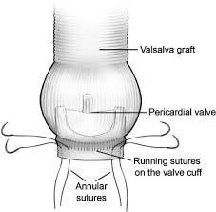
BENDALL PROCEDURE
Composite graft replacement of aortiv valve ,
aortic root and ascending aorta , with re implantation of
coronary arteries into the graft

Slide 78
Extensive repair
graft replacement of the ascending aorta and aortic arch and integrated stent grafting of the descending aorta -frozen elephant trunk
If the dissection progresses into the supra-aortic branches, rather than the classic ‘island’ technique, end-to-end grafting of all supra-aortic vessels may be considered, using individual grafts from the arch prosthesis

Slide 80
Malperfusion syndrome
30% -dynamic compression of the Tl or extension of the intimal flap into the organ/peripheral arteries, resulting in static ‘stenosis-like’ obstruction
surgical/hybrid treatment - Fenestration of the intimal in dynamic malperfusion syndrome, to create a sufficient distal communication between the TL and FL to depressurize the FL
Brockenborough needle using a transfemoral approach at the level of the maximum compression of the TL
scissor technique

Slide 81
Acute Type B aortic dissection
lower acute mortality - in-hospital mortality rates of approximately 10%
uncomplicated type B dissection- in-hospital mortality rate is much lower— 1% to 6% - medical therapy
complicated type B dissection -higher mortality rate

Slide 82
In the IRAD era- 57% of patients with acute type B dissection were treated medically, 32% received endovascular therapy, and 7% were treated with OSR,with in-hospital mortality rates of 10%, 14% and 21%, respectively
US National database trends report in-hospital mortality rates of 14.3% for type B dissection treated surgically and 7.9% treated with TEVAR
increased mortality rates -Increasing age, female sex, hypotension/shock, periaortic hematoma, aortic diameter larger than 5.5 cm, and malperfusion

Slide 83
Complicated Type B aortic dissection: endovascular therapy
TEVAR is the treatment of choice
indications –
visceral or limb ischemia
rupture or impending rupture
rapid expansion of the aortic diameter
uncontrollable pain
retrograde extension of the dissection into the ascending aorta

Slide 84
Aim
discontinue blood flow into the false lumen by covering the primary entry tear
to restore blood flow into the true lumen
false lumen depressurizes
preventing extension of dissection
false lumen thrombosis
aortic remodeling

Slide 85
Benefits
hemodynamic stabilization
reversal of endorgan ischemia
reduced morbidity and mortality
minimal procedural morbidity
interventional treatment of surgically unfit patients
short procedure time with minimal blood loss
decreased recovery time
potential cost savings

Slide 86
Size of stent graft should be based on diameter of aorta proximal to dissected segment ,applying almost no oversizing
Sufficient length (1.5- 2cm) of proximal landing zone
Ballooning is not recommended even if the stent graft is not fully expanded – chance of retrograde dissection and rupture of dissection membrane

Slide 87
If malperfusion of a branch vessel persists, branch vessel stenting or the technique of provisional extension to induce complete attachment (PETTICOAT)—in which the entry point is sealed with an endograft and the remaining thoracic aorta, abdominal aorta, and/or branch vessels are stented open—may correct the problem
Hybrid approaches (TEVAR and OSR) of dissections involving the arch and descending aorta may have lower risk than OSR
Retrograde ascending dissection is a potentially lethal complication that may occur during TEVAR – need of OSR team at institutions performing endografts

Slide 88
TRIALS

Slide 89
INSTEAD TRIAL
The Investigation of Stent Grafts in Patients with Type B AD (INSTEAD) trial
randomized
SAMPLE :140 patients with sub-acute (14 days) uncomplicated Type B AD
Two-year follow-up

Slide 90
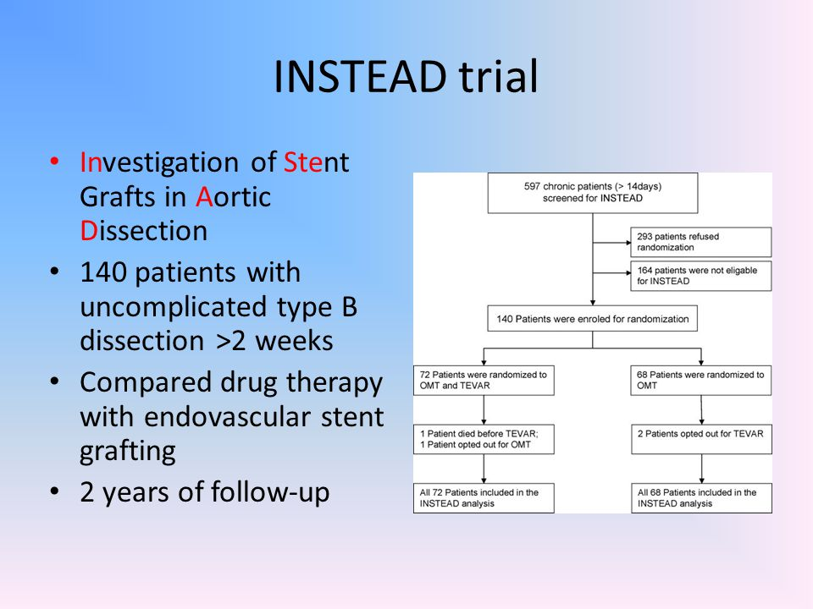

Slide 91
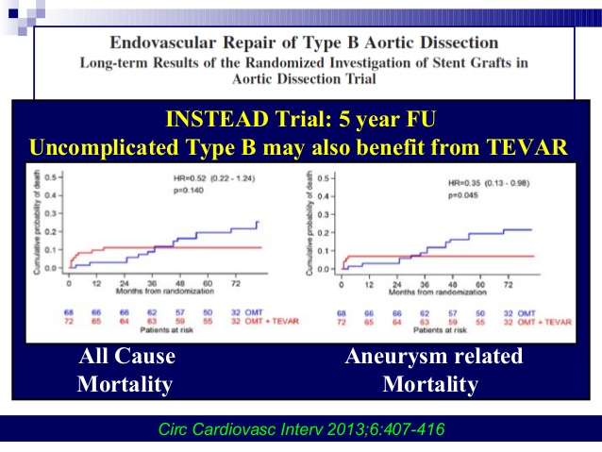

Slide 92
RESULTS:
no difference in all-cause mortality between patients with uncomplicated chronic type B dissection treated with TEVAR versus medical therapy
TEVAR had a significantly higher rate of aortic remodeling, including false lumen thrombosis and true lumen expansion (91% versus 19% for TEVAR versus medical therapy)
5-year all-cause mortality was not different between groups, but aorta-related mortality was significantly less in TEVAR treated patients, as was progressive aneurysmal enlargement

Slide 93
Extended follow-up of this study (INSTEAD-XL)
aorta-related mortality (6.9 vs. 19.3%, respectively; P ¼ 0.04) and disease progression (27.0 vs.46.1%, respectively; P ¼ 0.04) were significantly lower after 5 years in TEVAR patients compared with those receiving medical therapy only

Slide 94
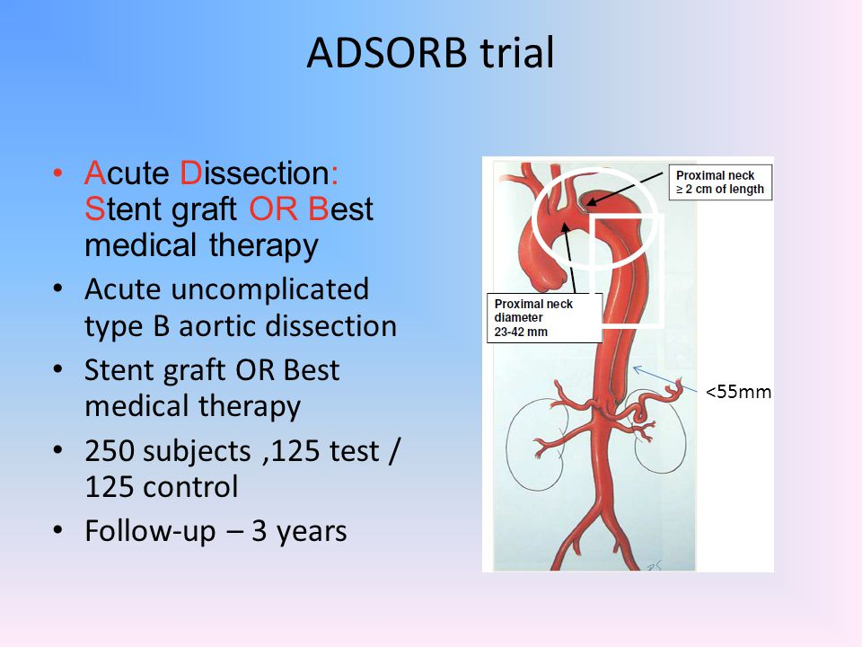

Slide 95
ADSORB trial -results-TEVAR improved aortic remodeling compared to medical therapy, but with no difference in rupture or in dissection-related or overall mortality after 1 year; 3-year data are forthcoming

Slide 96
STABLE trial
evaluate the treatment of complicated type B dissection with endovascular grafts compiling a 30-day mortality rate of 4.7%
Favorable aortic remodeling occurred and follow-up through 5-years is ongoing dissection
DISSECTION trial treated complicated type B dissection with TEVAR, reporting a 30- day mortality of 8% and 12-month mortality of 15%

Slide 97
chronic type B aortic dissection
Management is conservative usually
Typical indications for TEVAR (or OSR)
  progressive aortic enlargement (>10 mm/yr)
  aneurysmal enlargement (>55 mm)
  malperfusion syndromes
  recurrent pain
high rates of operative mortality (OSR, 5.6% to 21%; TEVAR, 0 to 14%) and complications (stroke: OSR, 0 to 13%;TEVAR, 0 to 12%; spinal cord ischemia: OSR, 0 to 16%; TEVAR, 0 to 13%; renal failure: OSR, 0 to 33%; TEVAR, 0 to 34%)
Reintervention rates were also high (OSR, 6% to 29%; TEVAR, 4% to 47%).

Slide 101
Long-Term Therapy and Follow-Up
Short- and long-term survival rates for type A aortic dissection range between 52% and 94% at 1 year and between 45% and 88% at 5 years Others report that patients with type A dissection who survive surgery have survival rates of approximately 90% at 1 year, 75% at 5 years, and 54% at 10 years
Medically treated patients with type A aortic dissection have a very high mortality rate, in excess of 20% by 24 hours and 50% in the first week after diagnosis

Slide 104
Long-term management after aortic dissection includes
medical therapy- BP control
screening the patient and first-degree relatives for heritable disorders associated with aortic dissection
serial imaging of the aorta
lifestyle modifications
Betablockers -drugs of first choice (effect on aortic stress and dP/dt and lower requirement for late surgery in follow-up)
Calcium channel blockers and ACE inhibitors -improve survival after type B dissection and ACE inhibitors may be associated with lower rates of late aortic events
Smoking cessation and risk factor modification for degenerative disease are also important

Slide 105
Lifestyle modifications –
Isometric activities lead to increased BP and aortic wall stress
Many need to change jobs, modify their work
low to moderate levels are considered safe and participation in exercise may lessen depression and lower BP

Slide 107
genetic predisposition to aortic disease
syndromic features recognized as MFS or LDS; features of these disorders should be sought on examination
dural ectasia—widening or enlargement of the dural canal, usually in the lumbosacral spine—on CT or MRI often indicates an underlying genetic aneurysm syndrome
BAV - a familial condition in 9% of cases; other patients will have nonsyndromic familial TAA or dissection syndromes
family studies -20% of individuals with a TAA or dissection will have another first-degree relative with thoracic aortic disease

Slide 108
late aneurysm formation
Risk factors :aortic dilation, hypertension, nonresection of the false lumen, larger false lumen diameter (>22 mm), entry tear diameter larger than 10 mm, and partial false lumen thrombosis
A patent false lumen and a dilated descending aorta (>45 mm) are risk factors for aneurysm and reintervention
Patients with partial false-lumen thrombosis have higher mortality at follow-up

Slide 110
Aortic Dissection Variants

Slide 111
INTRAMURAL HEMATOMA(10-20%)
hematoma develops in the medial layer of the aortic wall with no evidence of an intimal flap
diagnosed - circular or crescent-shaped thickening of .5 mm of the aortic wall in the absence of detectable bloodflow
ascending aorta in 30%, the arch in 10%, and the descending aorta in 60% to 70%
Result from rupture of the vasa vasorum and subsequent mural hemorrhage- location in the outer aortic media, versus the inner medial location of a classic dissection. Micro–intimal tear may initiate IMH, with the intimal tear too small to detect by routine CT
Classified as type A or type B
Symptoms - acute chest and/or back pain predominating
Complications - AR, hemopericardium, or rupture, but malperfusion is less common
proximity to the adventitia explain- pleural effusion, pericardial effusion, and periaortic hematoma and underlies the higher risk for aortic rupture

Slide 112
Imaging studies - TEE, CT, and
TEE features -focal crescentic or circumferential aortic wall thickening of 5mm or more, an eccentric aortic lumen, displaced intimal calcification, and areas of echolucency within the aortic wall and no intimal flap or flow in the aortic wall
On non–contrast-enhanced CT, IMH appears as an area of high attenuation in the wall of the aorta

Slide 113
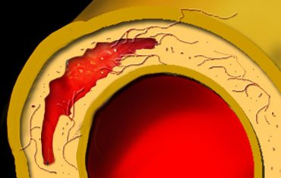
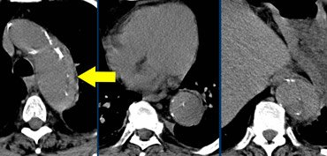
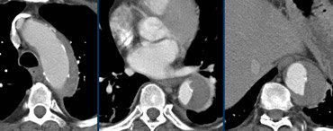
Intramural Hematoma (IMH)
Notes:
-Intramural bleeding within vasa vasorum of the media layer, I.e intact intima! -Classified the same way as AD. Male=Female, unlike in AD.-Mostly self-resolving (80%, esp if <2cm thick). Does not typically wedge around the True lumen in spirals like in AD. Upper image shows hyperdensity due to NECT study (can be mistaken as AD with thrombus in the false lumen). Lower images are CECT. Calicifications surround (like in AD) the True lumen.
-Higher mortality if >2cm think, >5cm length of Aorta involved, complicated by rupture into pericardium or pleura. Other complications include progression into AD in 18-47% of cases (worse if associated with PAU), rupture, formation of pseudoaneurysms.

Slide 114
MRI helps in differentiation of IMH from atherosclerotic thickening of the aorta, thrombus, or thrombosed dissection
Also provide a determination of the age of a haematoma, based on the signal characteristics of different degradation products of haemoglobin
Ulcerlike projections (ULP)- localized blood-filled pouch protruding into hematoma in aortic wall that may be caused by micro–intimal defects
Notes:
2. A, Computed tomography image of intramural hematoma (IMH) in descending thoracic aorta at diagnosis of acute aortic syndrome. B, Development of two ulcerlike projections in the same patient at 6 months (black arrows)

Slide 115
Notes:
Computed tomography images showing complete resorption of a proximal hematoma (upper panels) and development of typical aortic dissection during medical treatment

Slide 116
Notes:
Complete resolution of type B IMH has been described in more than 50% in some series, whereas others have progressed to frank dissection (5%), localized dissection or ULP (25%), rupture (4%), or late aneurysm formation (27%). The role of TEVAR is unclear in this disorder because there is no intimal defect or patent false lumen

Slide 117
Penetrating Atherosclerotic Aortic Ulcer(2–7%)
defined as ulceration of an aortic atherosclerotic plaque penetrating through the internal elastic lamina into the media
Propagation of the ulcerative process may either lead to IMH, pseudoaneurysm, or even aortic rupture, or an acute AD
typically elderly / have coexisting vascular disease
25% of PAUs found incidentally on imaging studies
most common location of PAU is the middle and lower descending thoracic aorta (Type B PAU), Less frequently in the aortic arch or abdominal aorta, while involvement of the ascending aorta is rare

Slide 118
Imaging techniques for PAUs include CT, MRI, TEE, and aortography
CT – focal aortic ulceration, associated IMH, and a calcified, displaced intima
Craterlike outpouching with irregular edges -difficult to differentiate PAU with an IMH from an IMH with ulcerlike projection
MRI - localized areas of high signal intensity in the aorta wall consistent with IMH, focal intimal thickening, and ulcerlike projections
TEE - aortic atherosclerosis with focal ulceration of the intima, often with hematoma

Slide 119
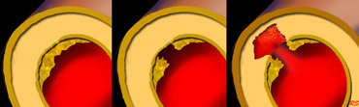
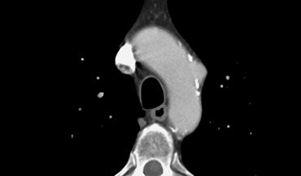
Penetrating Atherosclerotic Ulcerations
Notes:
-Always associated with athermatous plaque (mostly calcified) and within the descending aorta w/o intimal flap, usually multiple and smaller than AD and IMH, so Rx if required is usually endovascular. Patients almost always have atherosclerosis elsewhere, like CAD, CVD, and PAD, so although rarely cause classical AD, but patient may die of other causes of vasculopathy. Most common cause of saccular aneurysm, and in 40-50% may rupture. If associated with IMH then worse prognosis.
-Classified in the same way as AD.

Slide 120
uncertain natural history
A PAU may “stabilize” or lead to complications, including IMH, distal embolization, aortic rupture,pseudoaneurysm (contained rupture), aortic dissection, or development of a saccular or fusiform aneurysm
Indications for TEVAR or surgery may include the development of hemorrhage, periaortic hematoma, expanding pseudoaneurysm ,saccular aneurysm formation, continued pain, or rupture

Slide 121
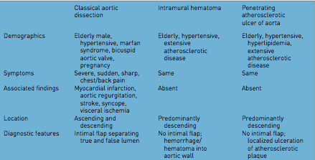
Notes:
-Already discussed above!

Slide 122
References
Braunwalds testbook of cardiology ,11e
Kirklin, Barratt-Boyes - Cardiac Surgery 2013
2014 ESC Guidelines on the diagnosis and treatment of aortic diseases
Update in the management of type B aortic dissection- Vascular Medicine 2016

Slide 123
THANK YOU

Slide 124
MCQ 1
Most commoly involved epicardial coronary is….
LAD
LCX
RCA
RI

Slide 125
MCQ 2
A.MFS 1.FBN1
B.loeys dietz syndrome 2.TGFBR1
C.Familial AAD 3.COL3A1
D.ehler danlos syndrome 4.ACTA2

Slide 126
MCQ 3
Which is not an indication of TEVAR in type B AD..
A. malperfusion
B. recurrent pain
C. aortic diameter >40mm
D. >10mm/yr growth

Slide 127
MCQ4
Which is the wrong statement
A. d dimer- < 500 ng/mL in 24hrs had a negative likelihood ratio of 0.07
B. MRI can assess branch vessel morphology when combined with contrast-enhanced MRA
C. TEVAR is the treatment of choice in uncomplicated type B AD
D. cog web is specific of true lumen

